Slide 1


KIET Group of Institutions Ghaziabad
project
Presentation

Slide 2
Title:- Innovative Platform for Learning Project Guide: Dr. Gaurav Dubey Amod Katiyar, Himanshu Kumar, Aniket Bhardwaj computer Science, KIET Group Of Institution

Slide 3
Abstract:- .
With the rise of new technologies, the most pressing question for students today is
what to learn and how to learn.
Students find it difficult to learn despite the fact that there are numerous options and that everything is so diverse. Nothing can ever be found on a single platform. We intend to solve this issue.
We will provide a platform that will give students an idea about the languages that are currently the most sought after in the industry, as well as a road map and resources from various platforms that will allow students to hone their grasp on the fundamental concepts and the entire language.

Slide 4
Technological advancements have dramatically increased access to learning materials and are rapidly changing the educational landscape . Learners interested in a specific topic are brought together to learn collaboratively via discussion forums, tweets, and other internet resources. The platform that we intend to build will provide a platform for comparing different existing languages that are currently the most in demand in the industry. Furthermore, the students will be able to share their own hands-on experience and will be able to guide and assist others in their learning journey.
Introduction:-

Slide 5
Despite the fact that there are many options and that everything is so diverse, students find it difficult to learn. Nothing can ever be found on a single platform. We intend to resolve this issue. The numerous possibilities that a student faces when deciding on a Specific domain to work in, the numerous questions that arise in his mind as to whether this is suitable for me or not, whether it will help me land a job in an MNC or not. Even after deciding on a domain, the next question is how to get there, how to get started, and how to properly learn each and every concept.
PROBLEM STATEMENT :-

Slide 6
Our goal is to address the issues that students face on a daily basis, which may not seem significant at first but can be extremely harmful in the long run. Choosing a domain that does not excite you or is not of your interest and devoting time to it will result in time wasted. Following a dedicated roadmap to learn the respective languages will assist students in learning the fundamental concepts and thereby strengthening their foundation. Learning the concepts in the prescribed order ensures that no important topics are overlooked and that the student has a thorough understanding of each and every topic.
OBJECTIVE

Slide 7
In the future, we will provide a much simpler user interface as well as various other resources to improve the quality of content offered. We will also be providing certification for the specific languages learned as well as practice sets for students to test their skills in real time. Offering a premium membership that includes dedicated videos on important topics as well as live sessions with pre-experienced people who are already working in the respective fields. Students who have completed all of the test series on the given topics will receive paid certified certification, and dedicated questions focusing on placements will also be provided.
Scope

Slide 8
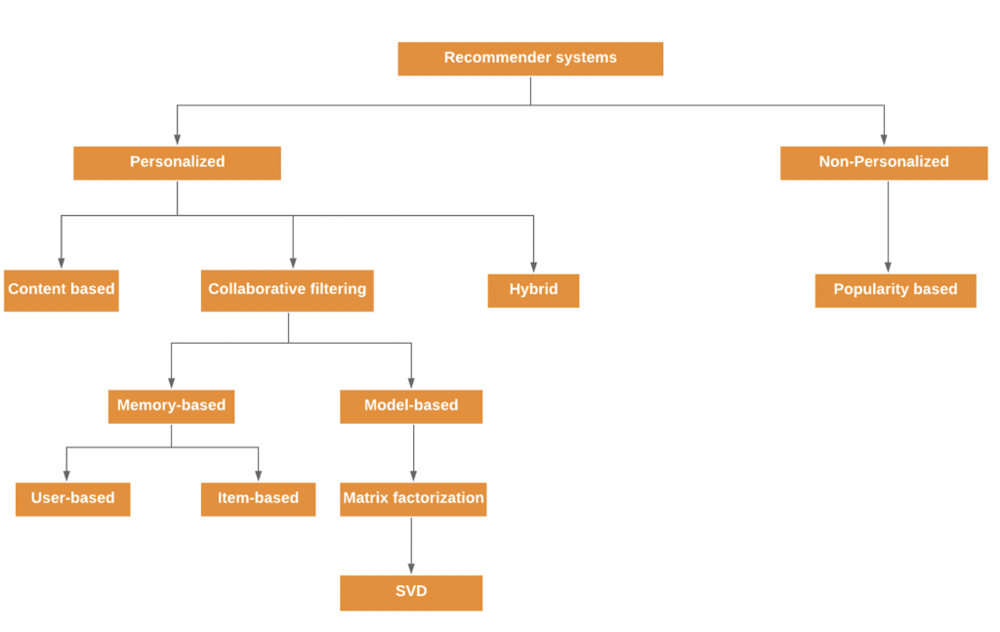
ML Approaches-
Methods and algorithms
We will deploy a model of recommended systems that will analyze historical data and trends to determine the popularity and usage of languages such as Java, C, and Python and then recommend it to students.
We will start with the most popular courses or languages.
Then, we will use nlp and API to extract the best links from the web for students to learn from.

Slide 9
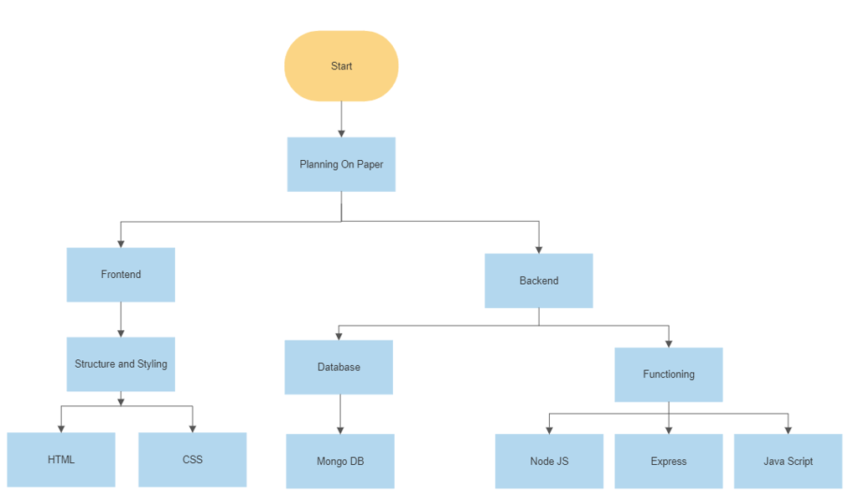
WEB DEVELOPMENT-
Methods and algorithms
The platform's development has been divided into two parts: frontend and backend . The frontend will be built with HTML and CSS, where HTML will provide the basic framework for the website and CSS will be used for styling.
The backend will be built with React, Express, and Node js, as well as JavaScript
MongoDB will be used to create a database that will store the students' information as well as their current progress.

Slide 10
Thank
You

